Slide 1


Rockbuster Stealth LLC
Mehreen Becker

Slide 2

Table of Contents
3
4
5
Business Problem
Goal
Revenue Overview
7
10
11
Customer Segment
Film & Category Analysis
Rental Trends
12
13
Findings
Next Steps

Slide 3
Business Problem
1
Declining DVD sales
2
Need to understand where customers are
3
What drives revenue
3

Slide 4



Goal
Identify our key markets
Figure out our revenue drivers
Find our customer segments
4

Slide 5
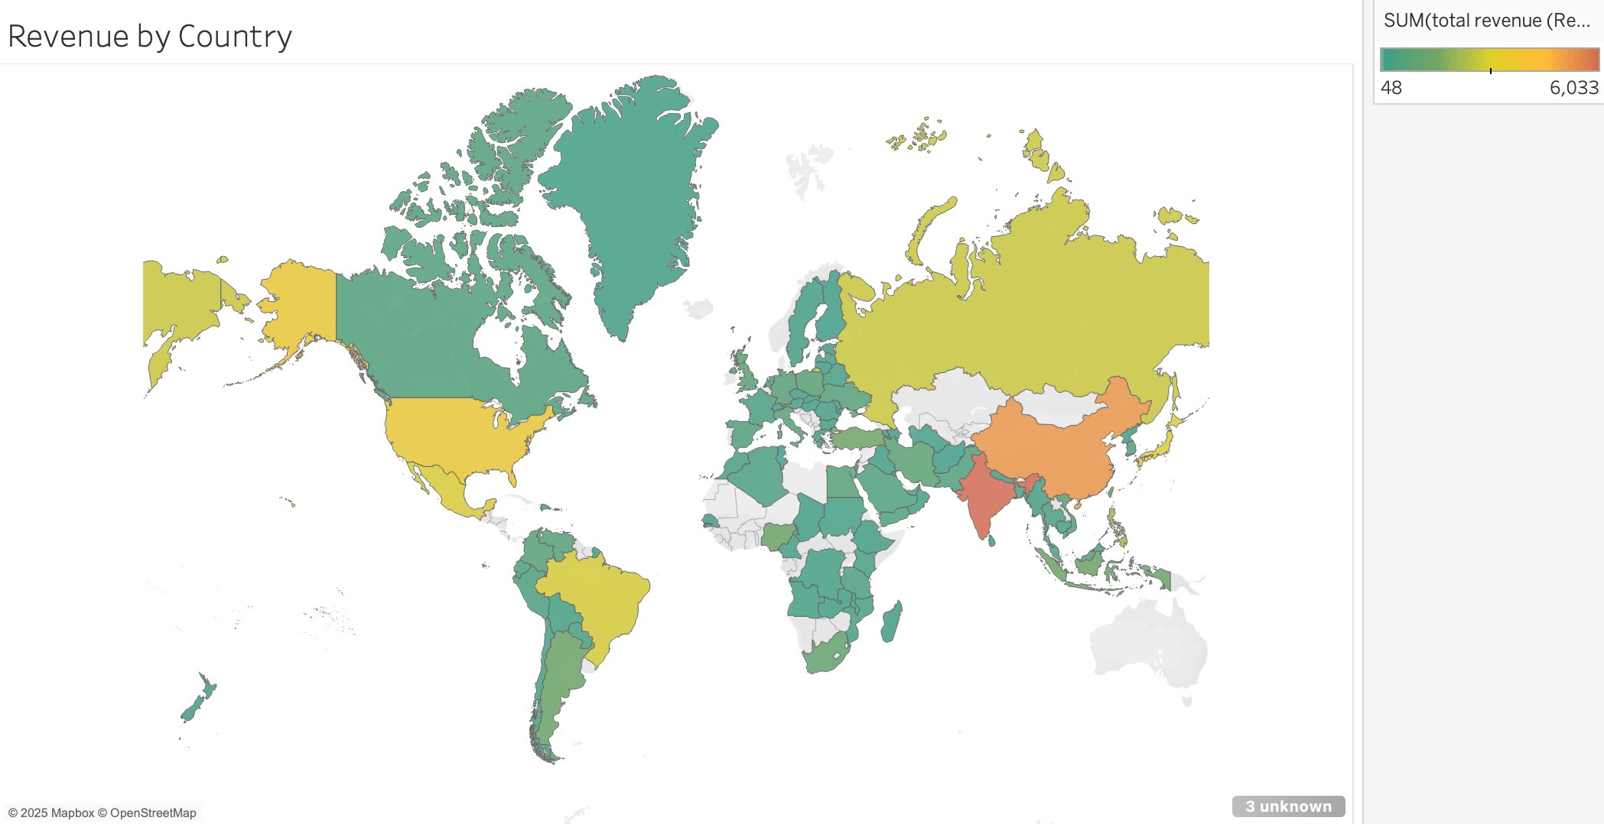
Revenue Overview

Slide 6
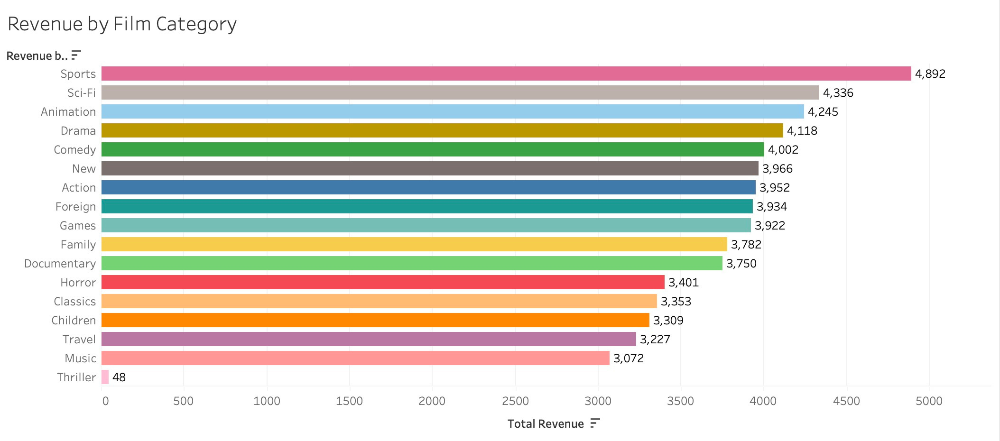
Revenue Overview

Slide 7
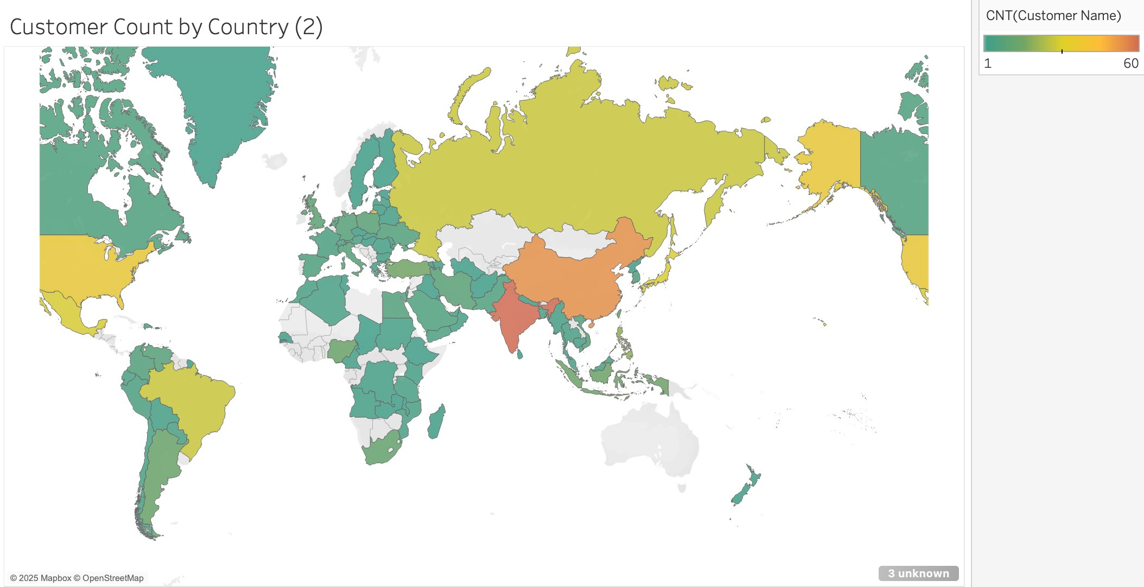
Customer Segment

Slide 8
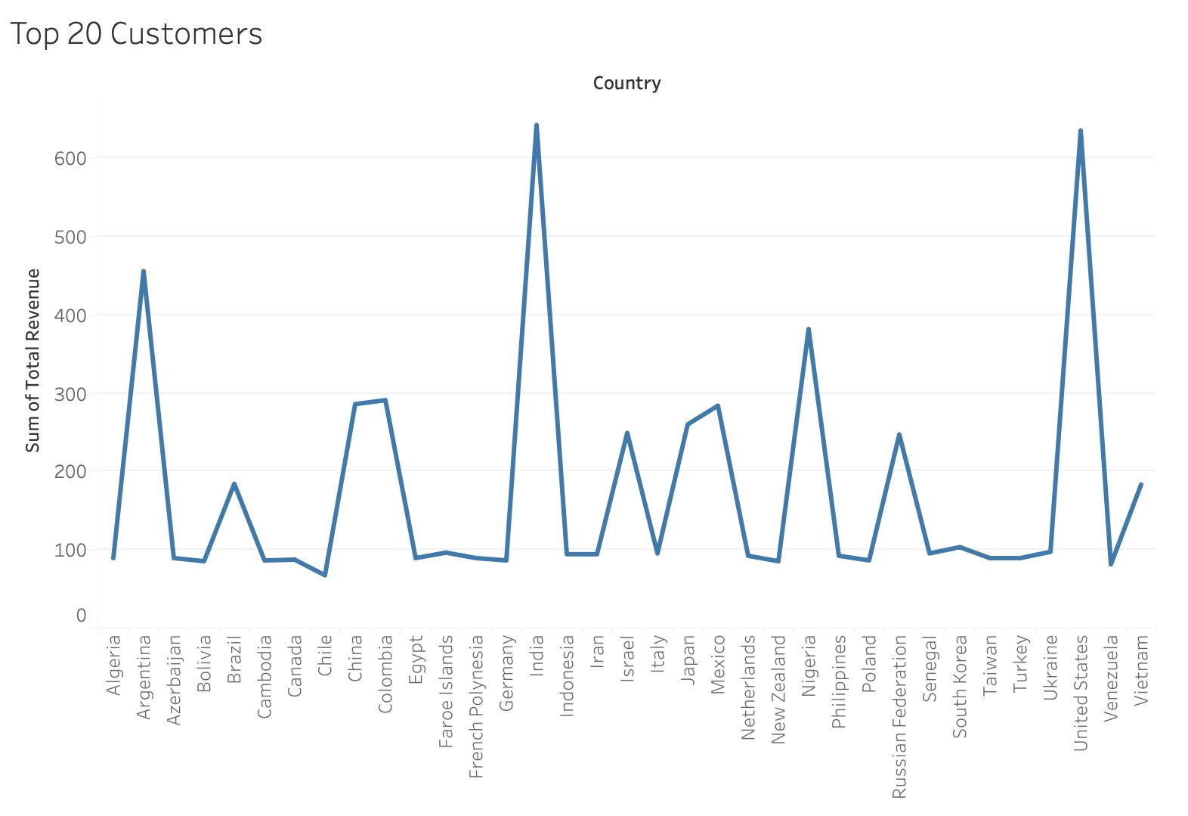
Customer Segment

Slide 9
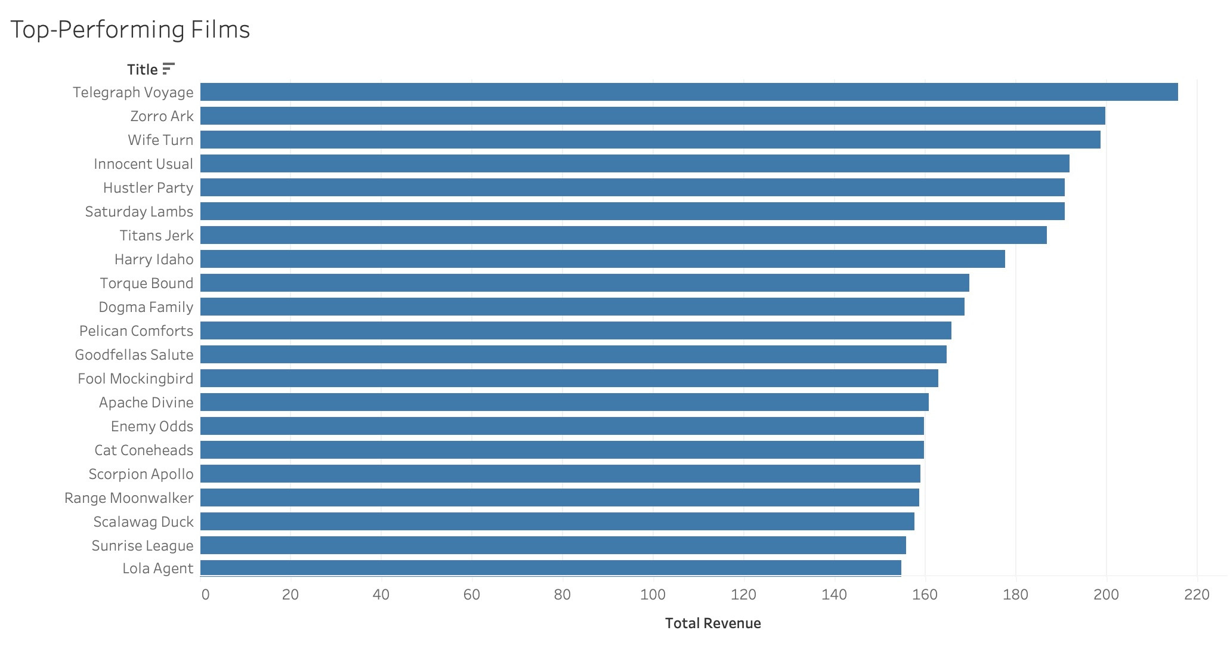
Customer Segment

Slide 10
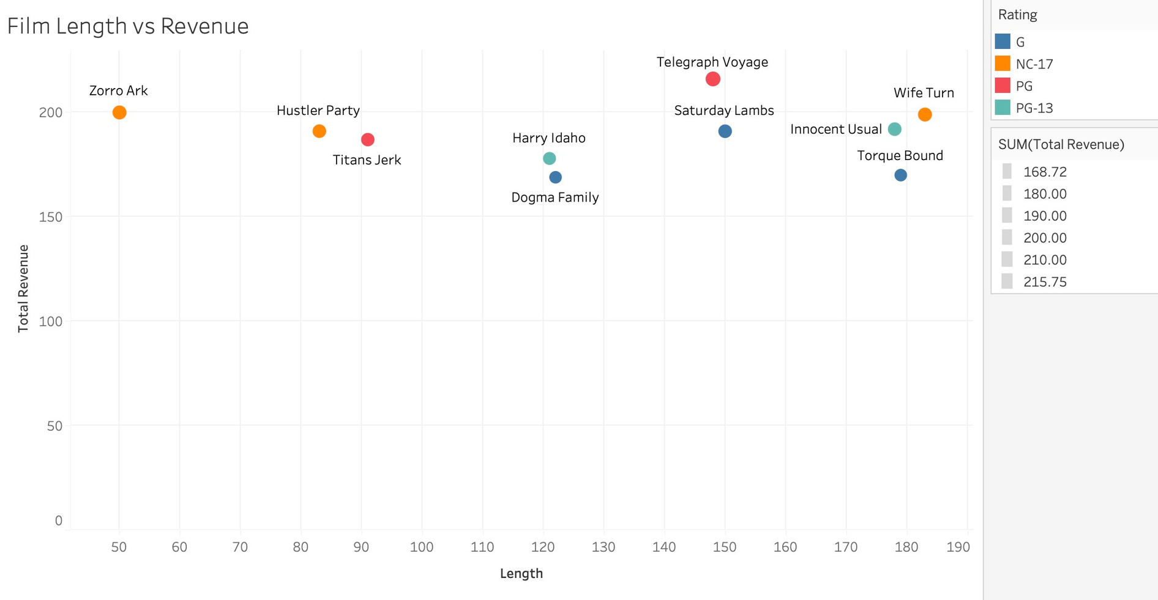
Film & Category Analysis

Slide 11
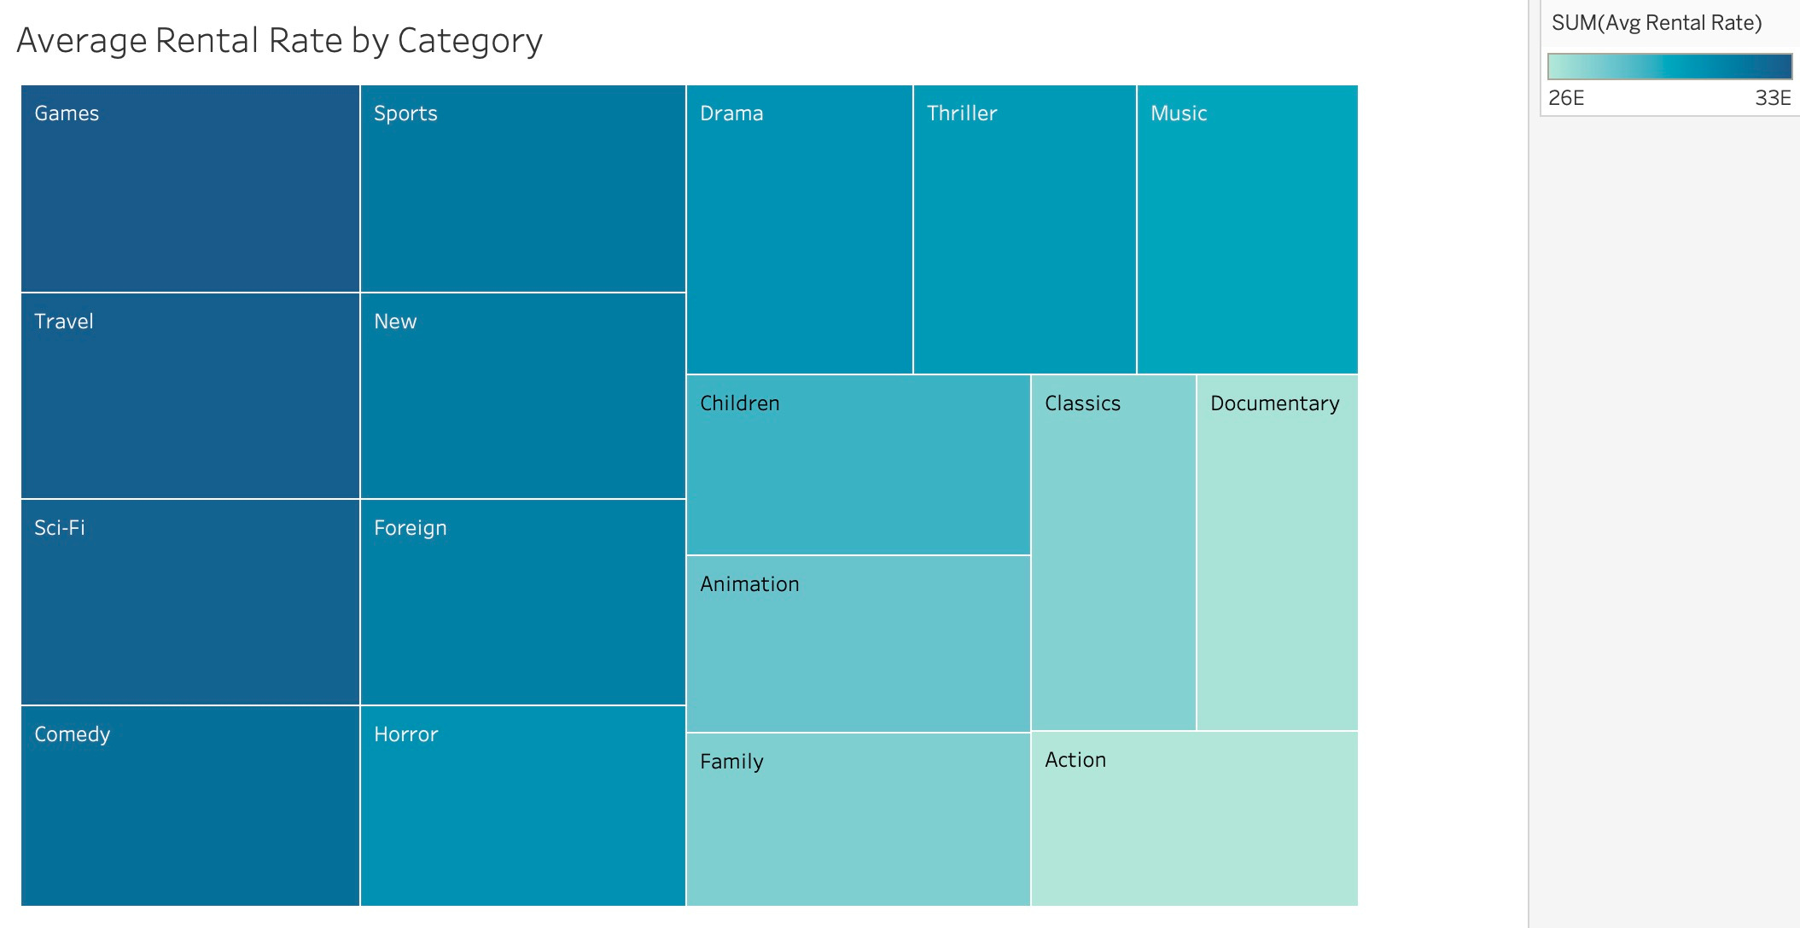
Rental Trends

Slide 12
Findings
Games, Travel and Sci-Fi seem to have the highest rental rates
Our top customers are in India, United States and Argentina
The highest revenue producing countries are India, China and the United States
Sports, Sci-Fi and Animation are to be the genres that create the most revenue
6

Slide 13
Next Steps
Launch streaming or digital rental services in the top 10 performing countries to capitalize on strong customer bases
Implement a loyalty or rewards program to incentivize high-value customers and increase retention
Localize offerings by tailoring film categories to regional preferences
Explore partnerships with studios to expand high-performing genres and exclusive content
Encourage a data-driven culture — train managers to interpret and act on analytical insights

Slide 14

The End
THANK YOU FOR LISTENING

